Slide 1
Implementing GitHub Actions continuous integration to reduce error rates in ecological data collection
Prof. Albert Y. Kim akim04@smith.edu
Smith College
Harvard Forest Wednesday, March 8th, 2023

Slide 2
Show Don’t Tell:
https://github.com/rudeboybert/live-data

Slide 3




Field
GitHub
triggers
Action Files:
workflow.yaml
Observes and records
runs
Any sorts of files:
Report.md
Map.png
…
Data file:
data.csv
R files:
Generate_report.R
Generate_map.R
…
generates
pushes
Lab
creates
downloads
Pulls and reads
Checks/corrects
Flowchart credit: Valentine Herrman

Slide 4
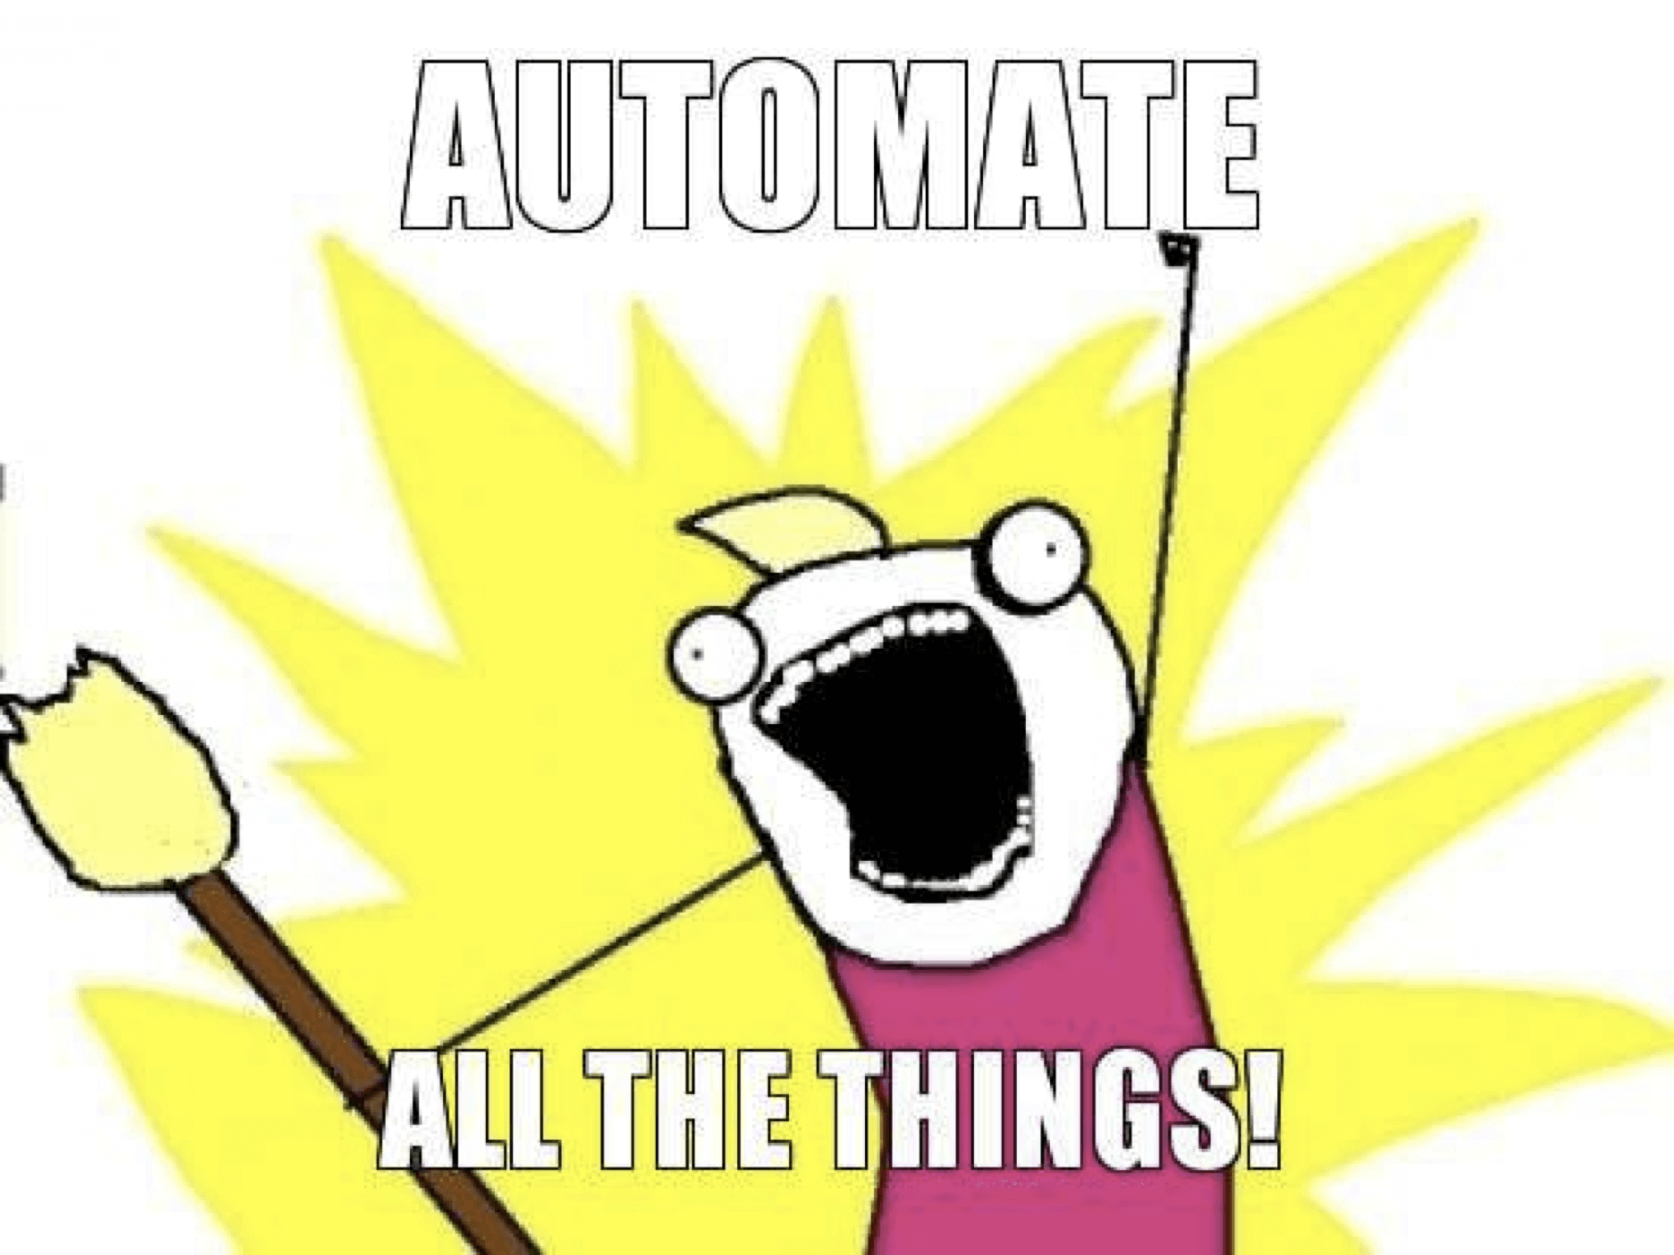
What is continuous integration?
Primarily a software engineering tool
No need to run code locally, rather “trigger” a remote job every time you push commits to GitHub
Checks & tests end-to-end replicability of your code:
1.Start: A fresh copy of your OS
2.Reinstalls all software & packages
3.Runs all code
4.End: Test reports & desired outputs
i.e. Outsource to the machines
GitHub Actions is one possible CI tool

Slide 5
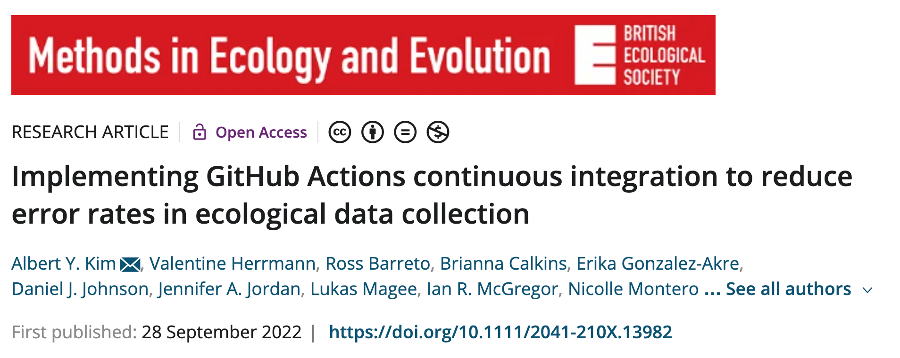
https://doi.org/10.1111/2041-210X.13982

Slide 6
Field
GitHub
triggers
Action Files:
workflow.yaml
Observes and records
runs
Any sorts of files:
Report.md
Map.png
…
Data file:
data.csv
R files:
Generate_report.R
Generate_map.R
…
generates
pushes
Lab
creates
downloads
Pulls and reads
Checks/corrects
Flowchart credit: Valentine Herrman

Slide 7
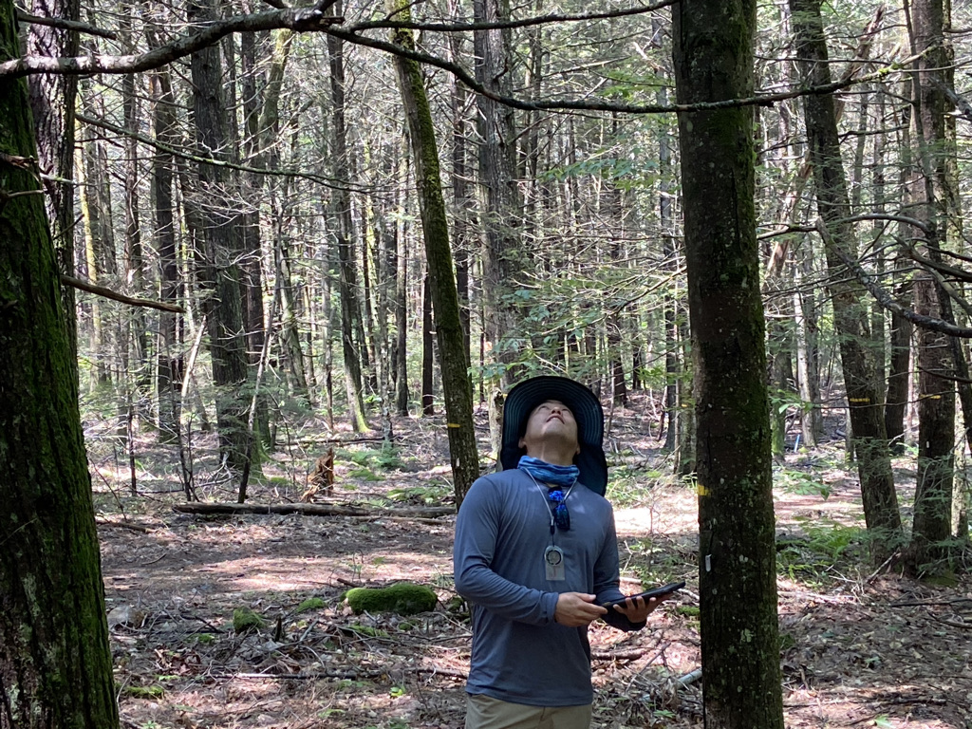
Implemented for Dan Johnson (Uflorida’s) 2021 Harvard Forest Mortality Census
https://github.com/SCBI-ForestGEO/HarvardMortality

Slide 8
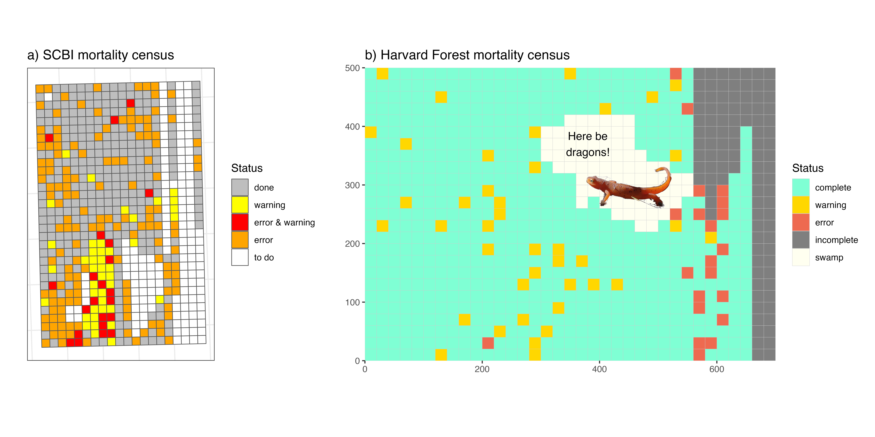
Mortality Completion Status Dashboards

Slide 9
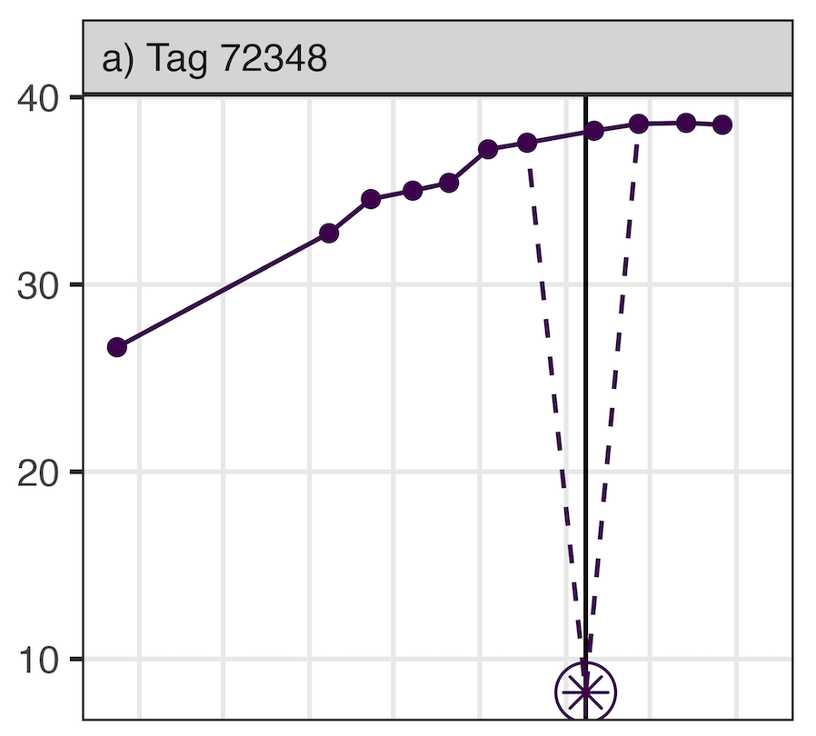
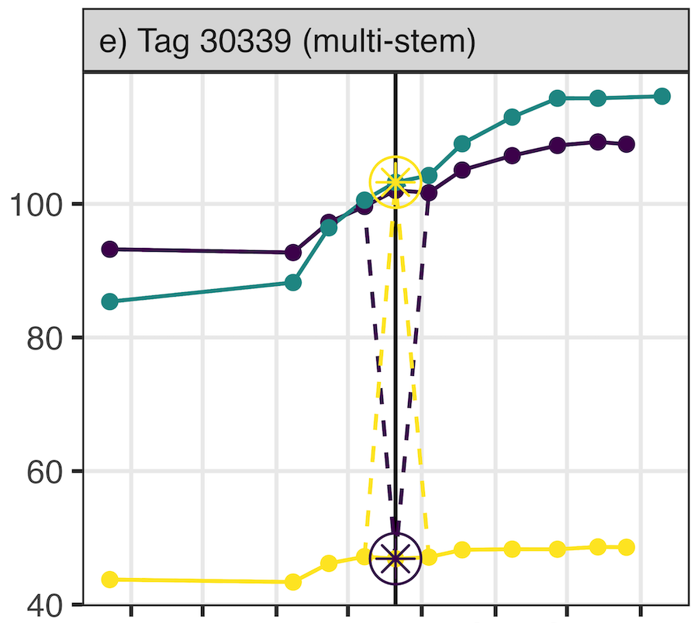
Dendroband Measurement Errors

Slide 10
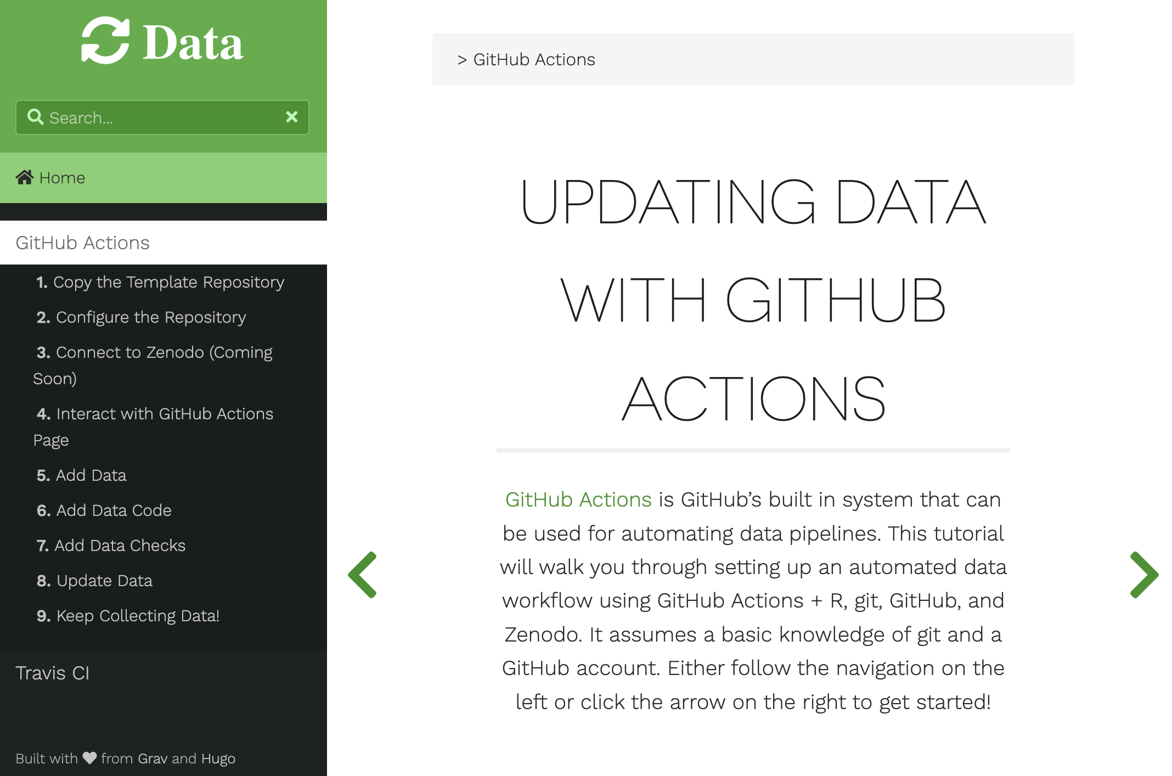
Getting Started Tutorial: www.updatingdata.org Assumes you’ve used GitHub and R

Slide 11
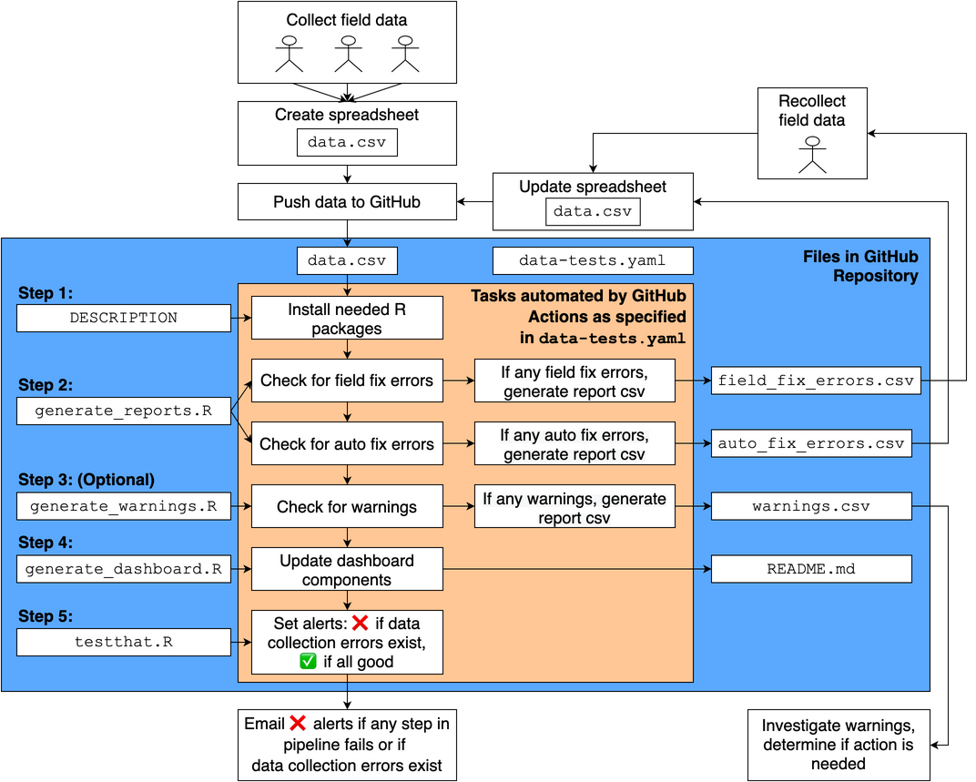
Engine file: https://github.com/SCBI-ForestGEO/SCBImortality/blob/main/.github/workflows/data-tests.yaml
YouTube tutorial: https://www.youtube.com/watch?v=JKF6aXtdLHs&feature=youtu.be

Slide 12
Next steps
Lukas Magee has extended system to Ordway-Swisher mortality census
Will be used in 2023 SCBI census for error checking, dashboard population, etc. (Data will collected on iPads running ArcGIS)
Per Ecological Forecasting Initiative: accelerate timeline from data collection to result dissemination. Ex: https://portal.naturecast.org/ See White et al (2018) https://doi.org/10.1111/2041-210X.13104

Slide 13
Acknowledgements for Continuous Integration Implementation
Ethan White (University of Florida): Portal project served as inspiration
Kristina Anderson-Texeira (SCBI): Greenlighting at SCBI
Valentine Herrmann (SCBI): implemented first iteration
Dan Johnson & team (University of Florida): Greenlighting at HF
Jess Shue (SERC and SCBI): Data collection step and dendrobands system
Jen Jordan (SCBI and GMU): Dendrobands

